Slide 1
‘A Striking Takes Place’ A Lexical-Functional Analysis of the Irish Autonomous Verb
James West

Slide 2
https://github.com/jhwest987/Irish-Autonomous-XLE
Link to Code

Slide 3
Introduction
The autonomous form of the Irish verb is often translated as a passive, but the data paints a more complex picture
This presentation puts forward a theoretical analysis of the Irish autonomous verb
The analysis is then applied in a computer grammar that covers a fragment of the Irish language
Buailim an liathróid.
hit-PRES-1Sg the ball
‘I hit the ball.’
Buailtear an liathróid.
hit-PRES-AUTO the ball
‘The ball is hit.’

Slide 4
Pieces of the Puzzle
1. The autonomous verb is fully productive across all tenses and moods and for all verbs (even for intransitives).
Siúladh.
walk-PAST-AUTO
‘(Someone) walked.’

Slide 5
Pieces of the Puzzle
2. The autonomous verb may stand alone as a complete sentence, even when the verb would normally require a direct object.
Buailtear.
strike-PRES-AUTO
‘(Someone) strikes.’
“A striking takes place.” (Christian Brothers 1902)

Slide 6
Pieces of the Puzzle
3. The subject of the autonomous verb can’t participate in subject-shifting constructions (possession, emotional states).
Tá leabhar agam.
be-PRES a book at PRO-1Sg
‘I have a book.’
(lit. ‘A book is at me.’)

Slide 7
Pieces of the Puzzle
4. The autonomous verb coexists with a “true” passive construction which promotes its object to subject.
Léitear an leabhar.
read-PRES-AUTO the book
‘The book is read.’ (or ‘(Someone) reads the book.’)
Tá sé léite.
be-PRES PRO-M3Sg-NOM read-VAdj
‘It is read.’

Slide 8
Pieces of the Puzzle
5. The object of the autonomous verb does not get promoted to subject and remains in the accusative.
Féictear é.
see-PRES-AUTO PRO-M3Sg-ACC
‘(Someone) sees him.’
*Féictear sé.
see-PRES-AUTO PRO-M3Sg-NOM
‘He is seen.’

Slide 9
Pieces of the Puzzle
6. The autonomous verb may be used with an oblique agent.
Caithfear 1.39 milliún Euro á caitheamh acu.
allocate-FUT-AUTO 1.39 million Euro for spending by them
‘1.39 million Euro will be allocated by them for spending.’
Note: *One will allocate 1.39 million Euro by them for spending.
fails because one already has a semantic role.

Slide 10
Pieces of the Puzzle
7. A lexically-restricted autonomous construction has been observed which resembles English It-extraposition and has a “dative” subject.
Ceapadh go raibh cuma ghruama orthu.
think-PAST-AUTO that they looked gloomy
‘It was thought that they looked gloomy.’
Ceapadh dom go raibh cuma ghruama orthu.
think-PAST-AUTO to PRO-1Sg that they looked gloomy
‘It seemed to me that they looked gloomy.’

Slide 11
Analyses in the Literature
The autonomous verb is an “impersonal passive” construction that exists alongside a “personal passive” construction (called “true passive” here) (Nolan 2001)
Nolan notes that the autonomous form is fully productive, has a specific but indefinite actor, can be used with an oblique agent
Problems:
Why have two constructions that do the same thing?
Why is the object of a transitive autonomous verb still accusative?
How to explain intransitive autonomous verbs?
Native speakers say the autonomous form is active (Christian Brothers 1902)

Slide 12
Analyses in the Literature
The subject of the autonomous verb can be analyzed with Arb, and functions like an indefinite pronoun (McCloskey 2007)
McCloskey compares the autonomous verb form to German man and Italian si, which are indefinite but are assigned a semantic role
McCloskey also notes the It-extraposition type construction, and poses an additional analysis to explain this (Arb on Tense is cancelled out by another Arb that appears on certain verbs)
Problems:
Analysis of autonomous is not unified across phenomena
Usage with oblique agent conflicts with assignment of semantic role

Slide 13
Lexical-Functional Grammar
A framework for syntactic analysis based on constituency and grammatical functions (Kaplan & Bresnan 1982, Bresnan 2000, Falk 2001)
Analysis given in two parts:
Constituent structure (C-structure) displayed through syntax trees
Functional structure (F-structure) displayed through attribute-value matrices

Slide 14
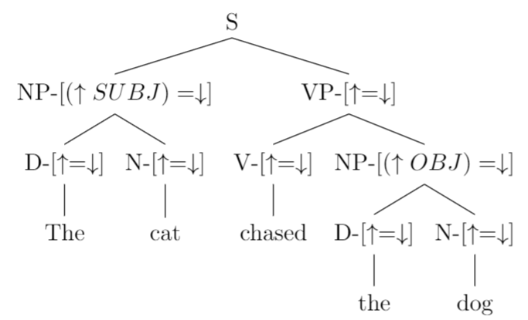
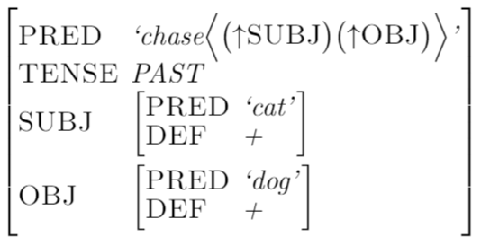
Lexical-Functional Grammar

Slide 15
Lexical-Functional Grammar
Has been applied to Irish before
PREDLINK grammatical relation effectively handles the Irish copula (which is also used for topicalization) (Sulger 2009)
Works better for Irish than single-tier analysis (e.g. predicate adjective is head of the sentence) or XCOMP analysis (e.g. predicate adjective or noun phrase is an open complement, which the subject controls)
PREDLINK is a closed-complement grammatical relation that can be any constituent type, used with copula and substantive verb
Subject-shifting analyzed with LFG (e.g. Irish expresses “to have” with a “be-at” construction) (Sulger 2011)

Slide 16
Pieces of the Puzzle (Review)
Feature | Implication
May stand alone as a complete sentence | Indefinite subject (and optionally, object)
Fully productive, including intransitives | Not passive
Co-exists with a “true” passive construction | Not passive
Object remains accusative | Not passive, but something occupies subject
May be used with an oblique agent | Passive, or no semantic agent
Can’t participate in subject shifting | No semantic agent
Lexically-restricted It-extraposition | No semantic agent

Slide 17
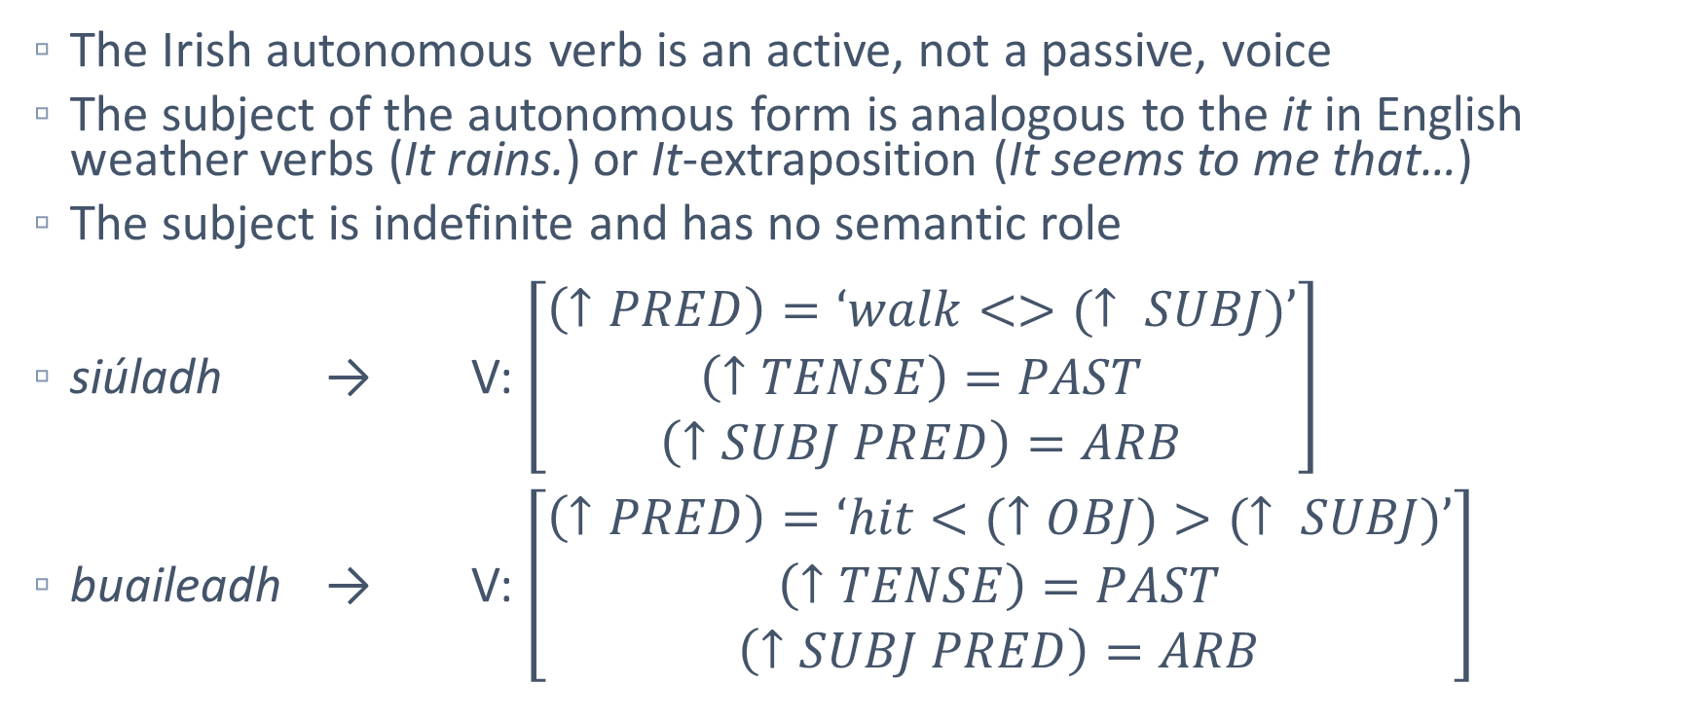
Lexical-Functional Analysis
The Irish autonomous verb is an active, not a passive, voice
The subject of the autonomous form is analogous to the it in English weather verbs (It rains.) or It-extraposition (It seems to me that…)
The subject is indefinite and has no semantic role
siúladh → V: $\left[\begin{matrix}\left(↑PRED\right)=‘walk<>(↑ SUBJ)’ \\ \left(↑TENSE\right)=PAST \\ \left(↑SUBJ PRED\right)=ARB\end{matrix}\right]$
buaileadh → V: $\left[\begin{matrix}\left(↑PRED\right)=‘hit<(↑OBJ)>(↑ SUBJ)’ \\ \left(↑TENSE\right)=PAST \\ \left(↑SUBJ PRED\right)=ARB\end{matrix}\right]$

Slide 18
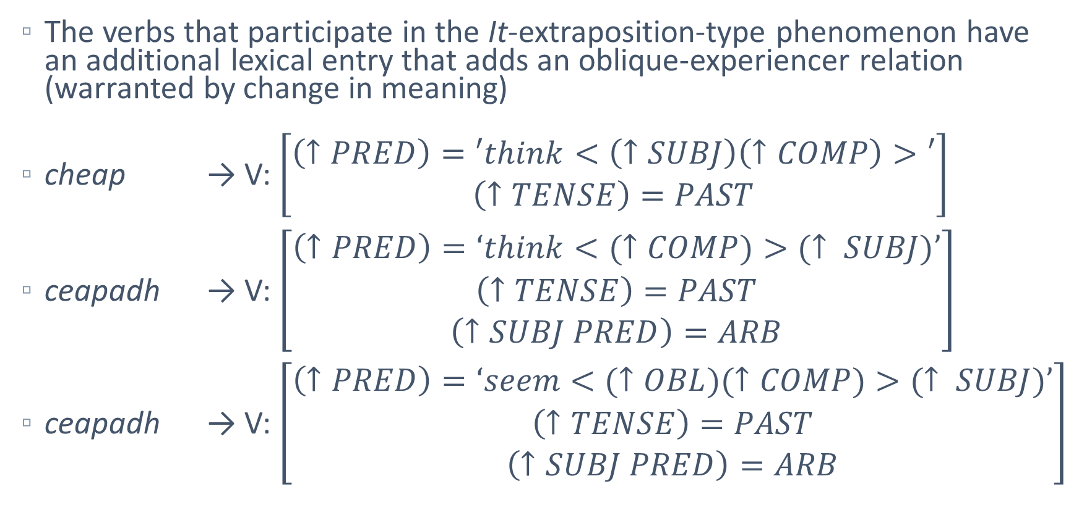
Lexical-Functional Analysis
The verbs that participate in the It-extraposition-type phenomenon have an additional lexical entry that adds an oblique-experiencer relation (warranted by change in meaning)
cheap → V: $\left[\begin{matrix}\left(↑PRED\right)=′think<\left(↑SUBJ\right)\left(↑COMP\right)>′ \\ \left(↑TENSE\right)=PAST\end{matrix}\right]$
ceapadh → V: $\left[\begin{matrix}\left(↑PRED\right)=‘think<(↑COMP)>(↑ SUBJ)’ \\ \left(↑TENSE\right)=PAST \\ \left(↑SUBJ PRED\right)=ARB\end{matrix}\right]$
ceapadh → V: $\left[\begin{matrix}\left(↑PRED\right)=‘seem<(↑OBL)(↑COMP)>(↑ SUBJ)’ \\ \left(↑TENSE\right)=PAST \\ \left(↑SUBJ PRED\right)=ARB\end{matrix}\right]$

Slide 19
Lexical-Functional Analysis
The issue of case:
Why does the object of a transitive verb in the autonomous form stay in the accusative case if the subject doesn’t have a semantic role? (see Dependent Case Theory, Marantz 2000)
One explanation is that the phenomenon is similar to English case marking, where only the “subject position” may be in the nominative case (e.g. prescriptive It was we. but descriptive It was us.)
In Irish, like English, the accusative is only opaquely marked in pronouns
The ending of the autonomous verb fills the “subject position” in Irish syntax (recall Buailim an liathróid. and Buailtear an liathróid.)

Slide 20
Computational Analysis
Computer grammar for a fragment of Irish capable of parsing and generating Irish sentences, written by hand
Analyses given in LFG notation (a C-structure tree and an F-structure attribute-value matrix)
Grammar written for the Xerox Linguistic Environment (XLE), licensed by the Palo Alto Research Center

Slide 21
Computational Analysis
Core grammar based on the over 70 sentences in McCloskey’s 2007 analysis of the autonomous verb
Additional sentences pulled from the Irish Universal Dependencies Treebank (UDT) version 2.5 (Rosen 2015)

Slide 22
Computational Analysis - Data
The Irish UDT v. 2.5 has 1,763 attested Irish sentences
To find instances of the It-extraposition phenomenon, the treebank was queried for verbs in the autonomous form with a direct dependent with the lemma do (the preposition “to”)
Query:
#x:[morph=(“Voice=Auto”)] > #y:[lemma=“do”] & !(“d’” = #y)
Results:
296 sentences (~17% of treebank) contained autonomous verbs
17 sentences were returned by the above query, and 7 of these were instances of the phenomenon (so ~2% of autonomous usage)

Slide 23
Computational Analysis - Data
…agus tchítear domhsa go ndearnadh leithcheal orthu.
‘...and it appears to me that they were excluded.’
Taibhsíonn na páirceanna níos lú ná mar a taibhsíodh dom iad a bheith an samhradh so caite.
‘The parks appeared smaller than how it appeared to me they were last summer.’
Títear dom, san am i láthair, nach bhfuil iontas ar mhuintir an cheantair...
‘It appears to me, at this time, that the people of this district are not surprised...’

Slide 24
Computational Analysis - Data
Ní bheadh sé tar éis dul tríd na heachtraí peannaideacha sin a fheictí dó...
‘He wouldn’t have gone through that painful event that it used to appear to him...’
Tuigtear dom, áfach, go bhfuil roinnt siopaí i dTír Chonaill atá sásta é a dhíol i gclúdach donn faoin chuntar.
‘I understand, however, that there are some shops in Tyrconnell that are satisfied selling it in a brown bag under the counter.’ (lit. ‘It understands to me...’)

Slide 25
Computational Analysis - Data
Rinneadh taibhreamh an oíche chéanna dúinn araon, domsa agus dósan...
‘We both had a dream the same night, me and him...’ (lit. ‘It did a dream to us both the same night, to me and to him...’)
Meabhraítear dhá arcaitíopa Mháire dúinn arís...
‘We are reminded of two archetypes of Mary again...’ (lit. ‘It reminds two archetypes of Mary to us...’)
Notable because McCloskey said the phenomenon was restricted to “psychological state verbs”, but these are phrasal

Slide 26
Computational Analysis - Results
Grammar writing decisions:
“Flat” sentence structure with no VP based on previous LFG work on Irish (Carnie 2005)
Tense/Aspect/Mood features specified at clausal level, determined by main verb
Standardized spelling according to An Caighdeán Oifigiúil (‘The Official Standard’), since many of McCloskey’s transcriptions used historical or dialectal spellings

Slide 27
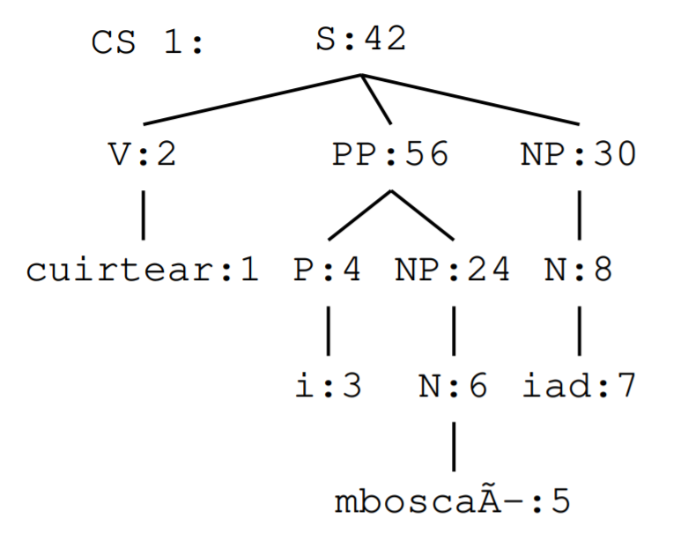
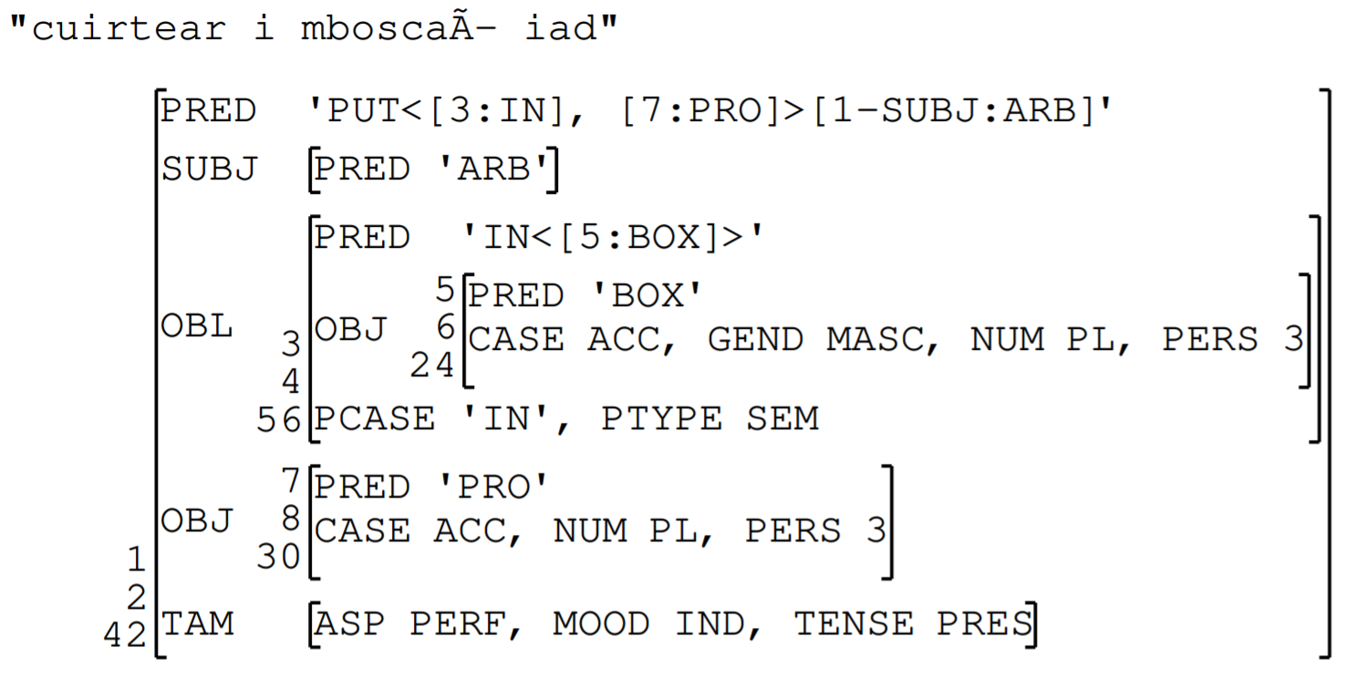
Computational Analysis - Results
Cuirtear i mboscaí iad.
‘(Someone) put them in boxes.’

Slide 28
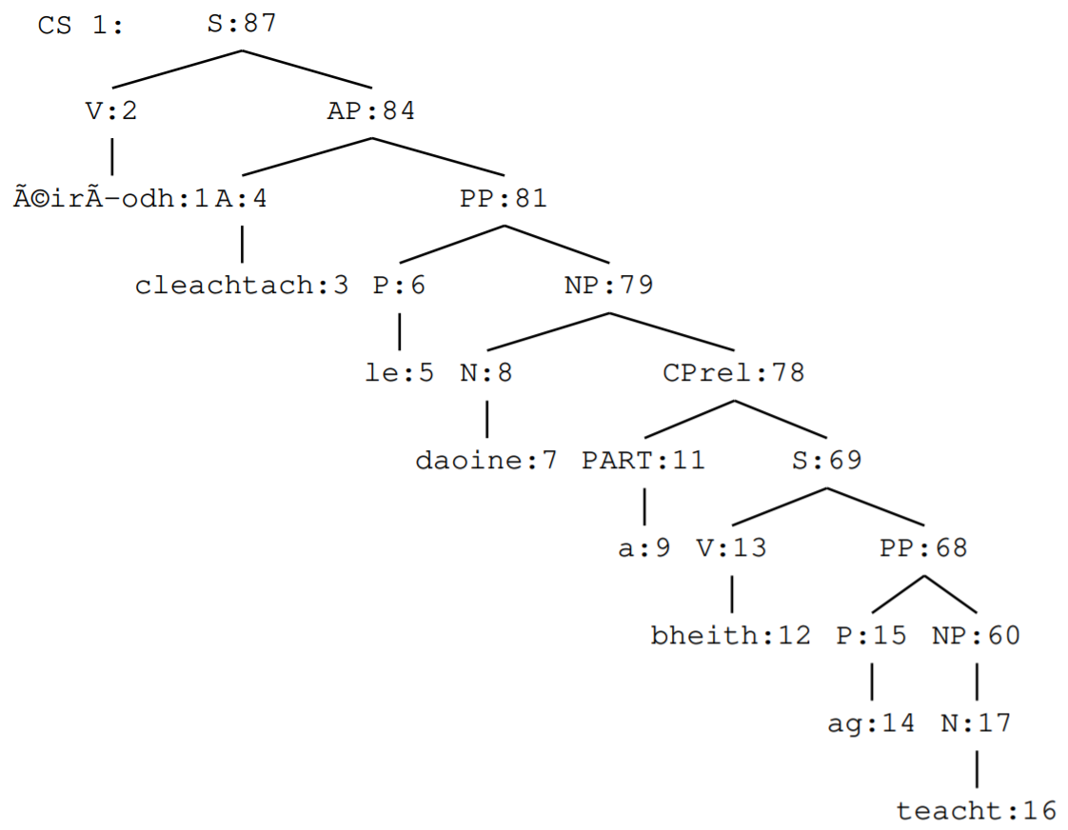
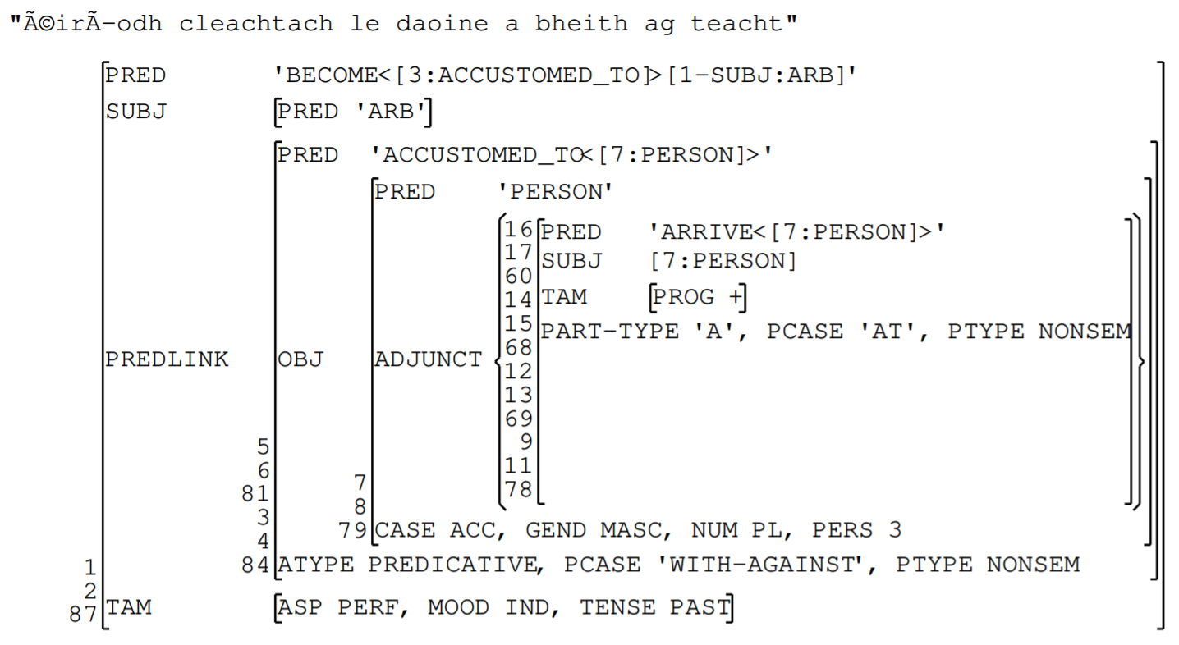
Computational Analysis - Results
Éiríodh cleachtach le daoine a bheith ag teacht.
‘One became accustomed to people arriving.’

Slide 29
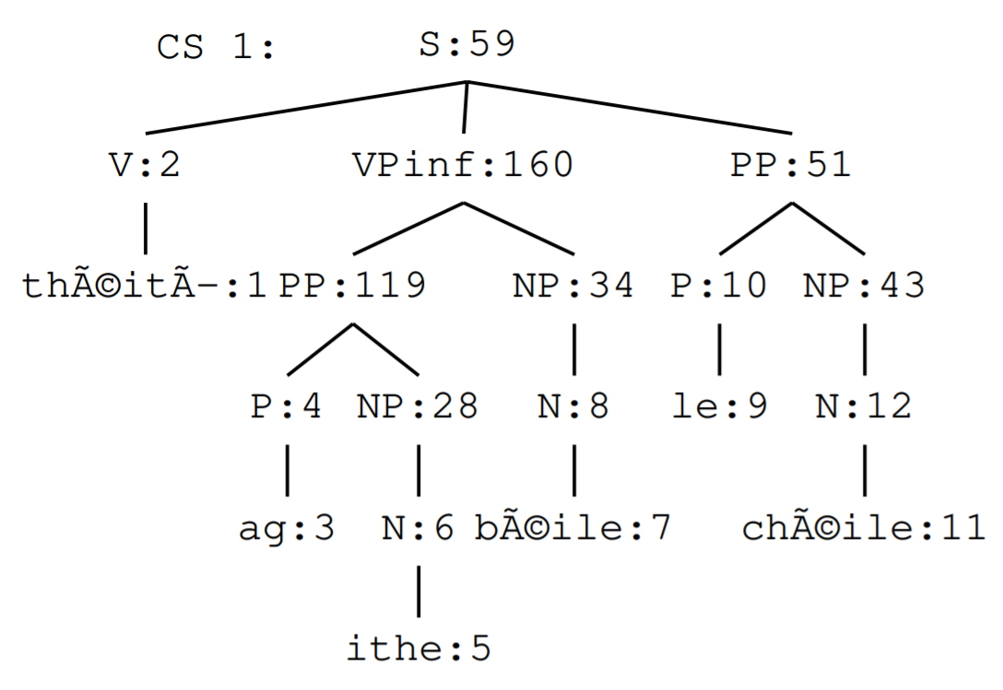
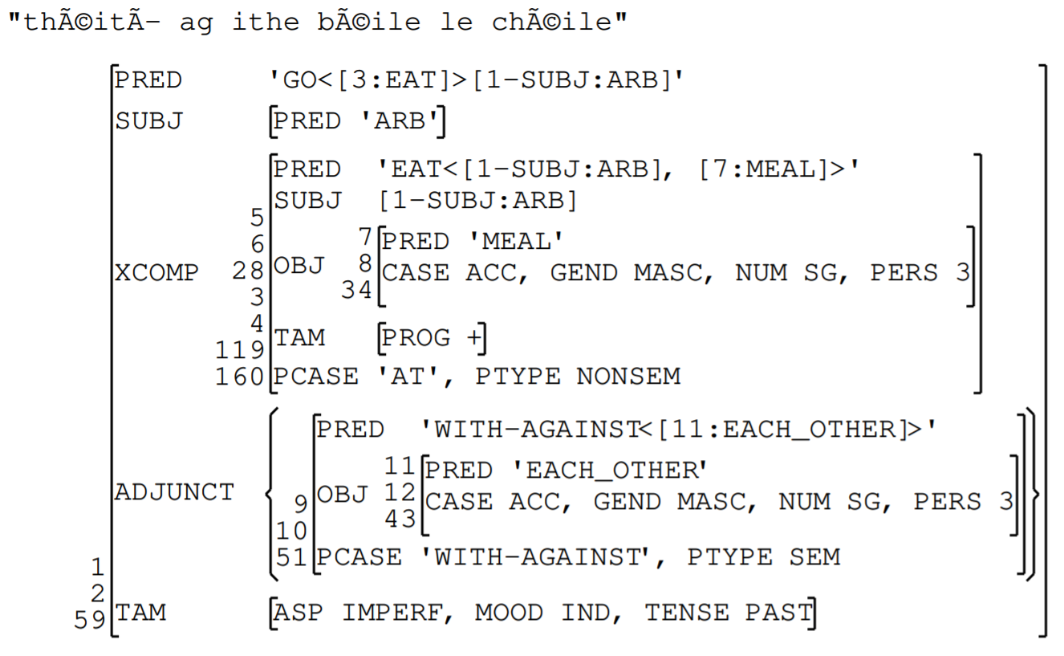
Computational Analysis - Results
Note the control relation here, but that English does not require a semantic role for control relations either, e.g. It was decided to go public. (McCloskey 2007)
Théití ag ithe béile le chéile.
‘People used to go eating a meal with each other.’
or ‘One used to go eating a meal with a companion.’

Slide 30
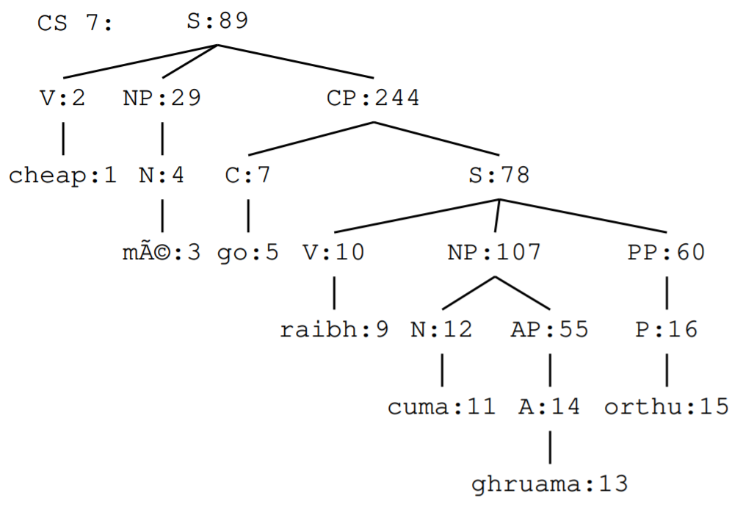
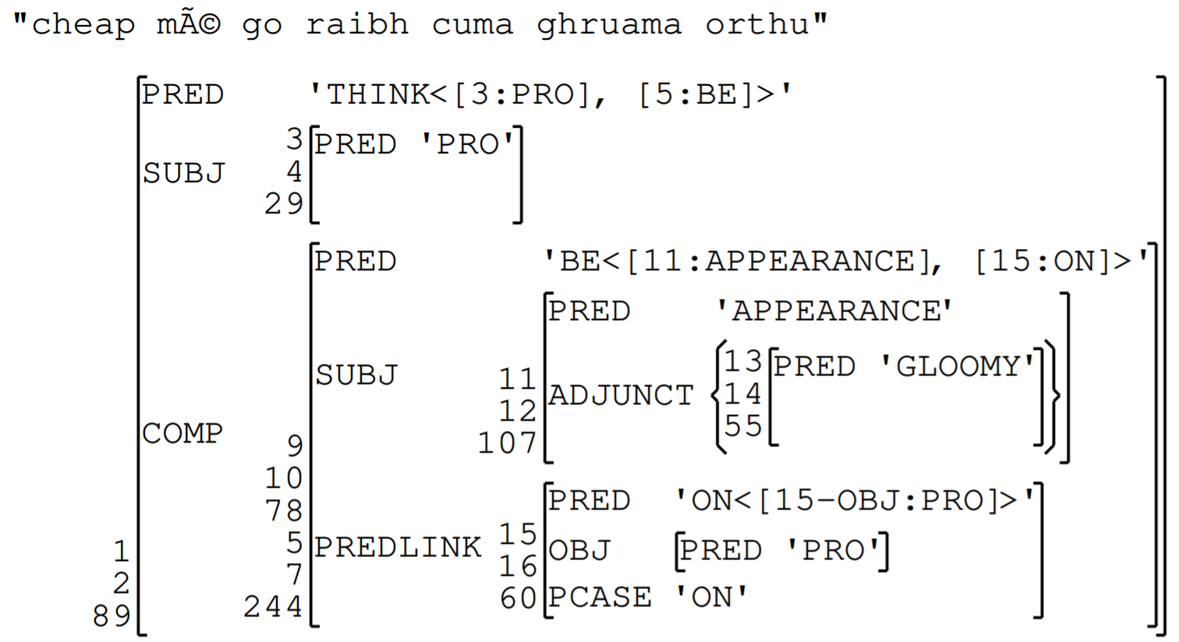
Computational Analysis - Results
Cheap mé go raibh cuma ghruama orthu.
‘I thought that they looked gloomy.’

Slide 31
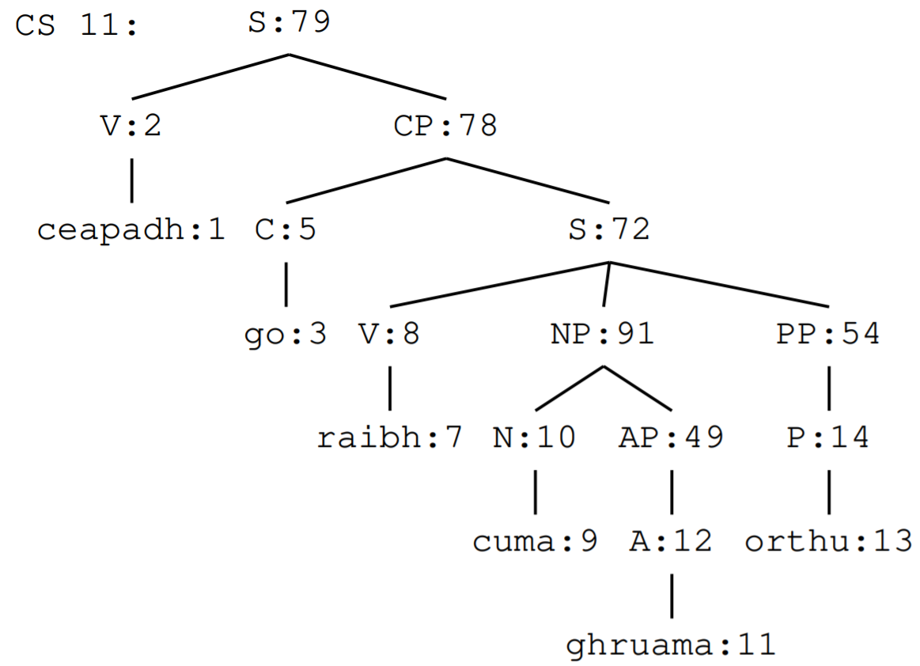
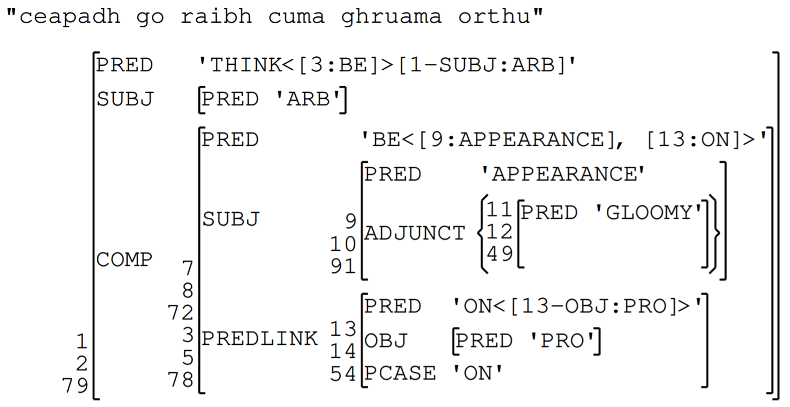
Computational Analysis - Results
Ceapadh go raibh cuma ghruama orthu.
‘It was thought that they looked gloomy.’

Slide 32
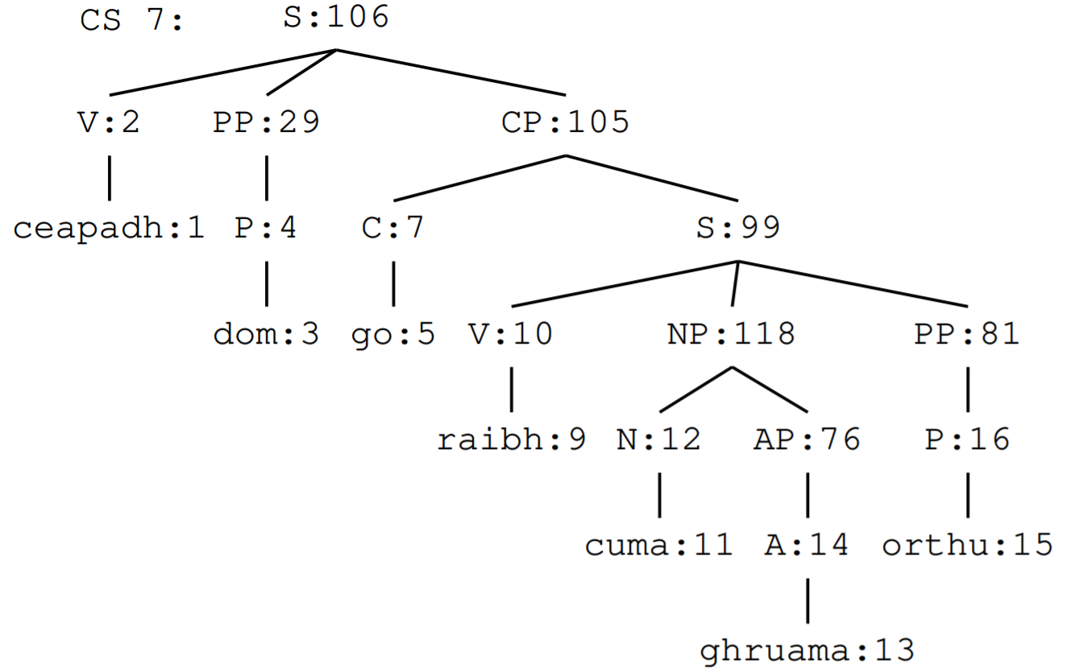
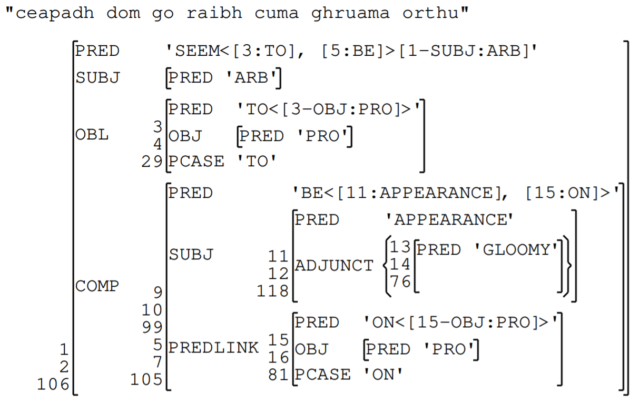
Computational Analysis - Results
Ceapadh dom go raibh cuma ghruama orthu.
‘It seemed to me that they looked gloomy.’

Slide 33
Implications
This theoretical analysis proposes one unified account of the autonomous verb across several constructions
Simplifies the syntactic analysis of the It-extraposition phenomenon and only adds lexical entries to the participating verbs, several of which take on new meanings anyway
Captures the full expressive range of Irish rather than lumping autonomous forms in with the passive

Slide 34
Implications
The new lexical rules also help in translation (e.g. using It seems to me… instead of, e.g. *To me was thought… for Ceapadh dom…)
Constructing computer grammars can contribute to text assistants, chatbots, machine translation, and more
Irish in particular is underrepresented in NLP and lacks the large corpora needed for deep learning techniques (Judge et al. 2012)
Human-written grammars can be constructed on much smaller datasets, and can later be used to automate the construction of larger databases

Slide 35
Conclusion
The Irish autonomous verb, across all its constructions, can be unified by representing its syntactic subject without a semantic role
This analysis is not just theoretical but was applied in a computer grammar
Hand-written computer grammars are especially effective for languages with few resources like Irish
Questions?

Slide 36
References
Bresnan, J. (2000). Lexical-functional syntax. Wiley-Blackwell.
The Christian Brothers. (1902). Graiméar na Gaedhilge. M. H. Gill, Dublin.
Carnie, A. (2005). “Flat structure, phrasal variability and VSO”. In: Journal of Celtic linguistics 9(1), pp. 13-31.
Crouch, D. et al. (2008). XLE documentation. Palo Alto Research Center.
Falk, Y. N. (2001). Lexical-functional grammar: An introduction to parallel constraint-based syntax. Center for the Study of Language and Information.
Judge, J. et al. (2012). The Irish language in the digital space. Ed. by H. Rehm & G. Uszkoreit. META-NET White Paper Series. Springer.
Marantz, A. (2000). “Case and licensing”. In: Arguments and case: Explaining Burzio’s generalization pp. 11-30. Ed. by E. Reuland. John Benjamins, Amsterdam.
McCloskey, J. (2007). “The grammar of autonomy in Irish”. In: Nat Lang Linguist Theory 25, pp. 825-857. DOI: https://doi.org/10.1007/s11049-007-9028-7.
Nolan, B. (2001). “Passive voice constructions in modern Irish”. In: The ITB Journal 2(1), pp. 51-78. DOI: https://doi.org/10.21427/D76D1K.
Ó Dónaill, N. (1977). Fócloir Gaeilge-Béarla.
Sulger, S. (2009). Irish clefting and information-structure. In: Proceedings of the LFG09 conference, pp. 562-582. Ed. by T. H. Butt & M. King. Center for the Study of Language and Information.
Sulger, S. (2011). A parallel analysis of have-type copular constructions in two have-less Indo-European languages. In: Proceedings of the LFG11 conference. Ed. by T. H. Butt & M. King. Center for the Study of Language and Information.
Rosen, V. et al. (2012). “An open infrastructure for advanced treebanking”. In: META-RESEARCH workshop on advanced treebanking at LREC2012, pp. 22-29. Ed. by J. Hajič, K. De Smedth, M. Tadić & A. Branco. Istanbul. http://clarino.uib.no/iness.

